Slide 1
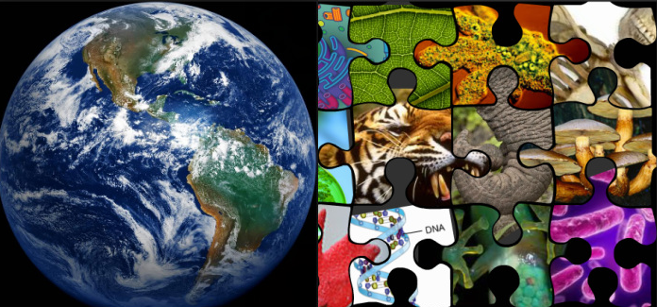
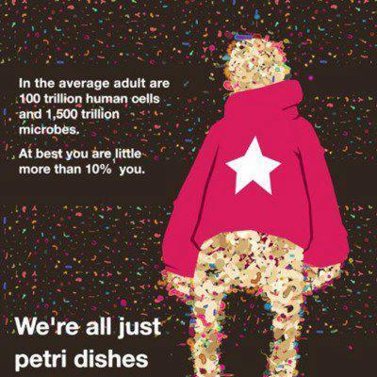
Welcome to LIFE SCIENCE !
Today in the OLS
While you wait answer the following question…
Unit 1 Lesson 5
Unit 2 Lesson 2
Growing Bacteria Lab Results/Lab Report
Today in the OLS
Did you petri dishes?
Yes, of course
B. Yes, but they are still watery!
Petri dishes? Lab?
Notes:
Push out unit 2 SG

Slide 2
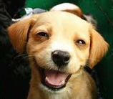
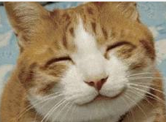
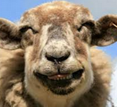
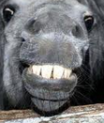
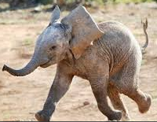
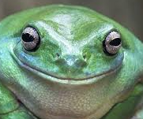
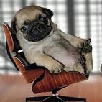
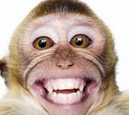
W
Monday 10/19
Tuesday 10/20
Wednesday 10/21
Unit 2 Lesson 2
Bacteria lab set up
Unit 2 Lesson 2
Bacteria lab
Wiggle room wed
LAB REPORT
Thursday 10/22
Friday 10/23
Weekly Review/
Quiz
Unit 2 Lesson 3
Cell organelles

Slide 3
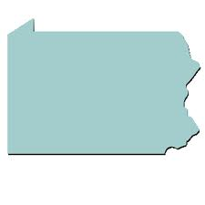
Our Goals for the day
Objectives:
Set up petri dishes and place bacteria in dishes
Notes:
https://www.youtube.com/watch?v=yfSGoSp97Ag&list=UUCahwwtTNfK_aRSLoy_Pbog

Slide 4
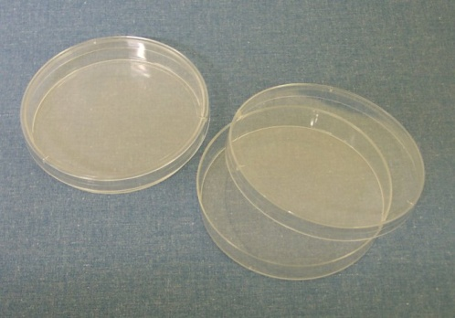
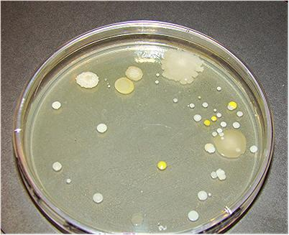
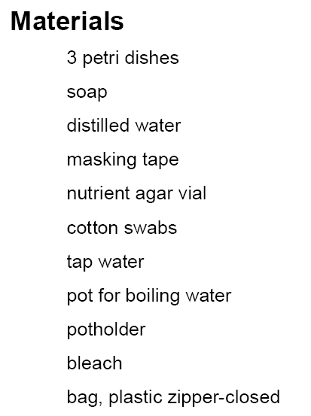
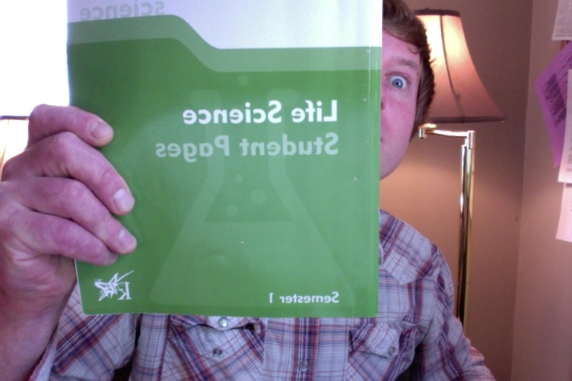
Unit 2 Lesson 2
Growing Bacteria from Clean and Dirty Hands Lab
Pages 63-64 in Student Pages
Also in the OLS Unit 2 Lesson 2
Notes:
http://quietube6.com/v.php/http://www.youtube.com/watch?v=yfSGoSp97Ag&feature=youtu.be
https://www.youtube.com/watch?v=yfSGoSp97Ag&list=UUCahwwtTNfK_aRSLoy_Pbog

Slide 5
The Scientific Method
Make observations about the problem and conduct research to review what other scientists have done.
State the Question
State the hypothesis predict what you think the answer to your question will be.
4. Set up an Experiment to test your Hypothesis
• materials—gather and record everything you need to do the experiment
• procedure—follow specific steps to carry out your experiment
• experiment—test your hypothesis according to the procedure
5. Collect data by describing what happened during the experiment.
6. Analyze the data/results of, or what happened during, the experiment.
Form conclusions and write the answer, if you found one, to the original
problem. Does your conclusion prove your hypothesis?
Notes:
How scientists answer questions and figure stuff out
Observation …Question..
Hypothesis
Design Experiment
Gather Data
Form a conclusion

Slide 6
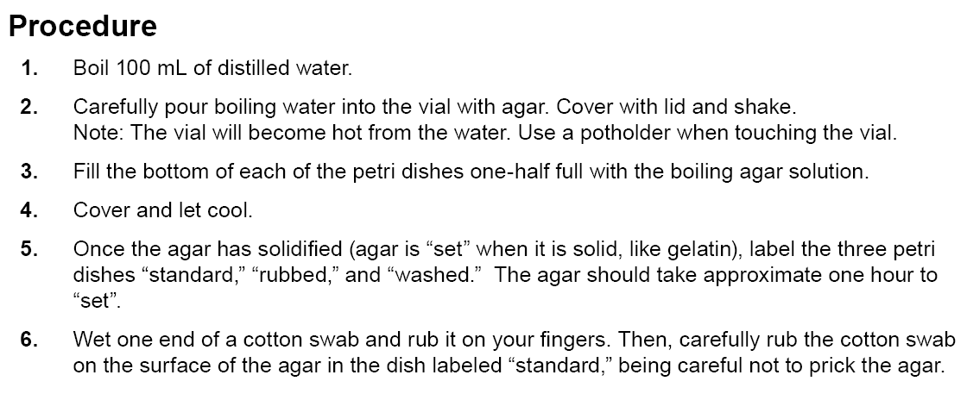
Growing Bacteria Experiment
1.CLEAN HANDS
2.DIRTY HANDS, AND 3.YOUR CHOICE
Dirty Hands
Notes:
Describe the lab…. Then show scots vid

Slide 7
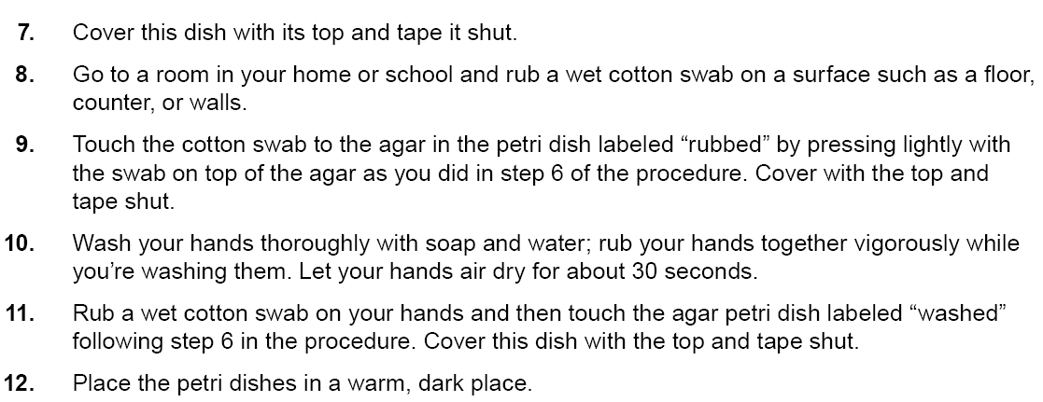
With the surface you rubbed
Hands

Slide 8
Petri Dish Label | Order of Bacteria Growth (1 – 3) 1 = least growth | Drawing | Brief Summary of what you see
Clean (washed) Hands
Dirty (unwashed) Hands
Your Choice

Slide 9
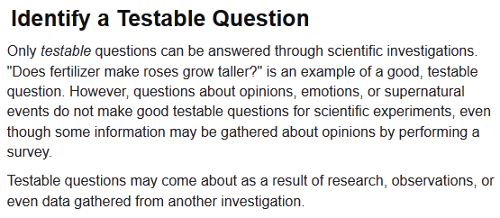
WHAT IS THE TEMPERATURE ON A HOT SUMMER DAY?
(write your answers in the chat)
Notes:
Ask is this a good scientific question? Why not?

Slide 10
QUESTIONS
Non-Scientific
Answers are different depending who you ask
Scientific
Can be answered with an investigation
Notes:
Have them write a nonscientific question… write some on the board and analyze

Slide 11
Which Questions are Scientific (Testable)? Which are Not?
Does the type of apple (Granny Smith or Red Delicious) affect
how many apples a horse will eat?
Is vegetarianism better than eating meat?
Does the type of wood (type of tree) affect how long it burns?
Notes:
Which ones are testable? Which not and why
Does the type of wood affect how long it burns?
Is vegetarianism better than eating meat?
Does the type (brand – Granny Smith vs. Red Delicious) of apple affect how many apples a horse will eat?
Take the vegetarianism ? And have them reword to make testable.

Slide 12
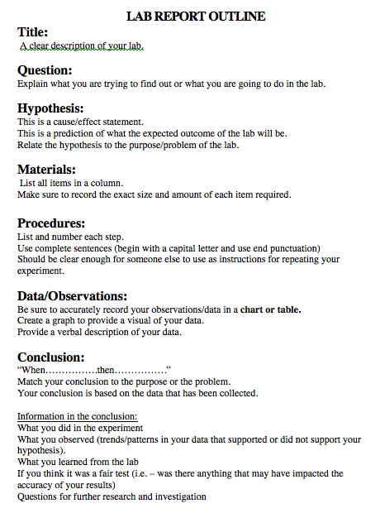
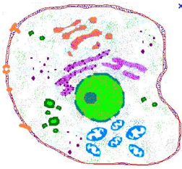
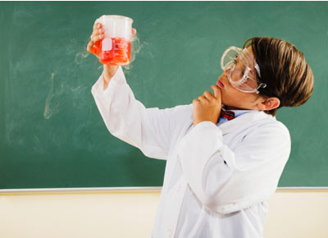
The Scientific Method
- A process that scientists use to investigate things
Anyone trying to solve a problem can make observations and use the scientific method.
Notes:
Tell them we will be using the scientific method to investigate and answer questions
This is the lab report we will be using this year.
Today we will focus on writing questions.

Slide 13
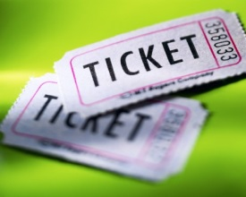
Life Science Homework
Make observations of petri dishes during class time tomorrow.
Class Ticket
Any questions about how to complete the Lab ?
Clemson Tigers Team Website-
Notes:
http://quietube6.com/v.php/http://www.youtube.com/watch?v=yfSGoSp97Ag&feature=youtu.be
http://youtu.be/yfSGoSp97Ag
http://clemtigers.weebly.com/
http://homebiology.blogspot.com/2009/05/growing-bacteria-cultures.html
http://mrilifescience.weebly.com/life-science-testsprojects.html

