Slide 1
Biome project
Biome Project
Biomes
Tundra
Taiga (Coniferous Forest)
Desert
Temperate Deciduous Forest
Tropical Rain Forest
Grassland
Each student will make a presentation describing one of the above Biomes. Each presentation will contain the sections described below, Climate and Location/Plant Species/ and Animal Species.
The project should contain a Power-Point Presentation consisting of at least five well-made slides.
.

Slide 2
The Climate and Location
Describe where your biome exists in the world.
Describe the climate.
The average temperature and average yearly rainfall.
The type of soil that can be found in your biome.
Descriptions of unique conditions in your biome such as, permafrost, length of night and day.
Any other aspect of your biome that is interesting to you.
Plant Species
A general description of how the climate and location affect the plant species in the biome.
Detailed descriptions of at least 3 plant species that live in the biome.
Adaptations to life in the biome.
Any other interesting, relevant information about the plant species.
Animal Species
A general description of how the climate and location affect the animal species in the biome.
Detailed descriptions of at least 3 animal species that live in the biome. Descriptions should include adaptations to life in the biome.
Any other interesting and relevant information about the animal species.
Sources:
You may use your textbook, online encyclopedias, and the following Internet websites:

Slide 3
http://www.ucmp.berkeley.edu/glossary/gloss5/biome/
http://www.enchantedlearning.com/biomes/
http://www.cotf.edu/ete/modules/msese/earthsysflr/biomes.html
http://www.blueplanetbiomes.org/world_biomes.htm
http://earthobservatory.nasa.gov/Experiments/Biome/biodesert.php
You may also explore the links attached to these sites for additional information.
***Plagiarism is unacceptable!! Do not cut and paste information from the Internet directly into your presentations. Put the information into your own words. I have read all of these websites and I will double-check them with your report***
Grading:
You will have three days in-class-time to complete this project. Any additional time you need to complete this project must be spent outside of class. I will be collecting you powerpoint slides by the end of the third work day
The Biome project is worth a maximum of 20 points.

Slide 4
What is a Biome?
Scientists have developed the term Biome to describe areas on the earth with similar climate, plants, and animals.
The plants and animals that live in a specific biome are physically well adapted for that area.
Plants and animals that live in a specific biome share similar characteristics with other plants and animals in that biome throughout the world.
The types of biomes that will be explored during this exercise include: Tundra, Deserts, Grasslands, Taiga, Temperate Forests, and Rainforests

Slide 5
Climate
A Biome us a large region characterized by a specific type of climate and the plants and animals that live there.
Climate is the average weather conditions in an area over a long period of time.
Different biomes support different organisms based on their climate.
Plants that require a lot of water must live in climates with a lot of precipitation (rain).
Animals that require the sun to keep them warm must live in a biome that has higher temperatures.

Slide 6
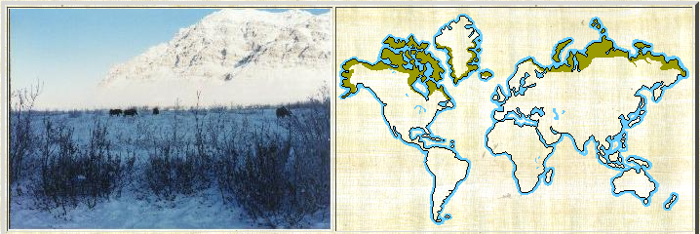
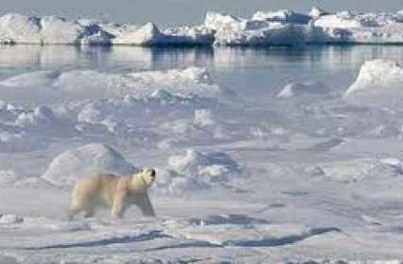
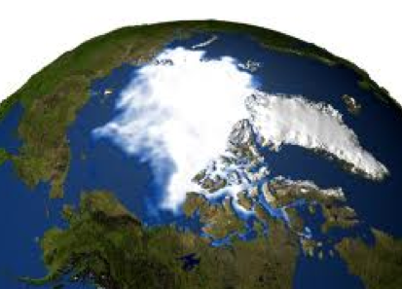
Arctic Tundra
A cold biome of the far north with very few trees .
What’s it like there?
The farthest north and coldest and driest of all the biomes
In the winter the temperature can reach -50°F and summer temperatures rarely get above 50°F.
The soil is frozen six inches below the ground, and is frozen for most of the year.
Temperature | Rainfall | Soil
-27°C to 5°C (-17°F to 41°F) | 0-25 cm per year | frozen

Slide 7
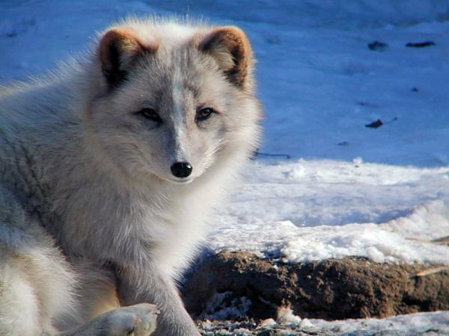
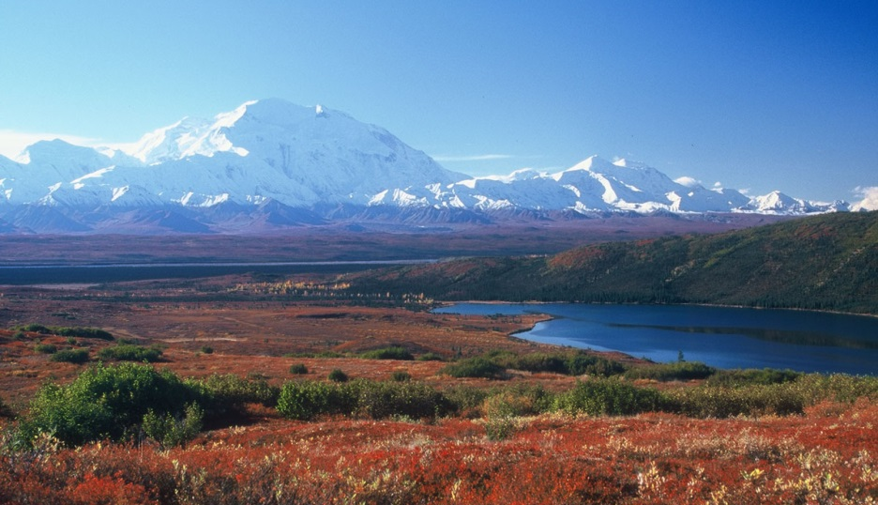
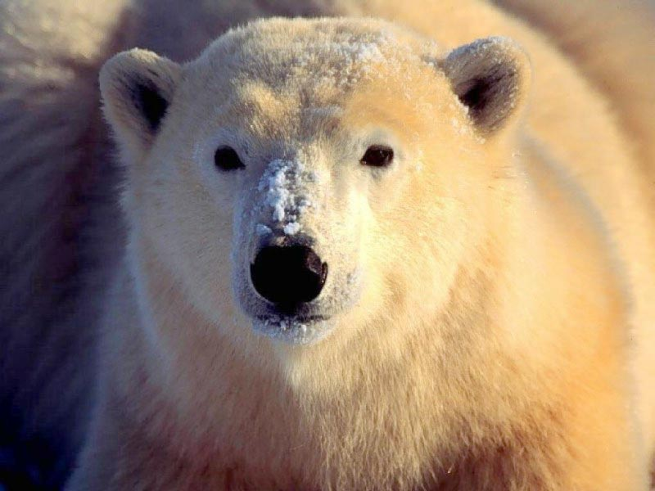
Artic Fox
Polar Bear
Location: Regions south of the ice caps in the Artic. In North America, Europe, and Siberia.
Description: Coldest biome and also covers 1/5 of the Earth’s surface.
Plants: lichens, mosses, grasses, sedges, shrubs. Almost no trees due to short growing season and permafrost
Animals: Every animal must adapt in order to survive. Some have grown thick fur which turns white in the winter. Others find a place to hibernate during the winter months.
Tundra

Slide 8
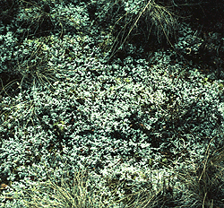
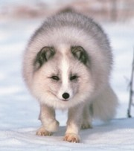
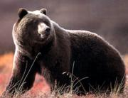
cottongrass
Tundra Plant Adaptations
Growing close to the ground
Having shallow roots to absorb the limited water resources.
Trees grow less than 1 m high!
Reindeer lichen
Tundra Animal Adaptations
Arctic fox
Grizzly Bear
Small ears
Insulation, thick coat
Many visitors, migration
Few predators
Little Competition

Slide 9
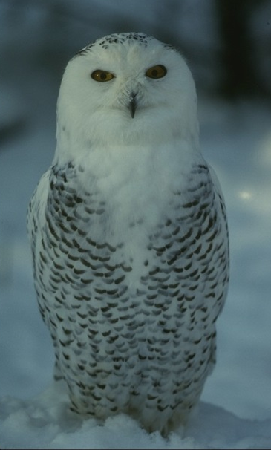
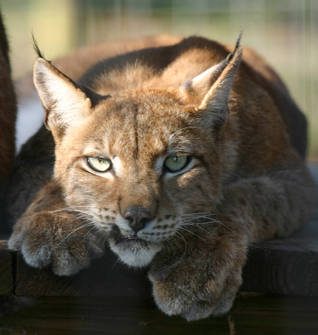
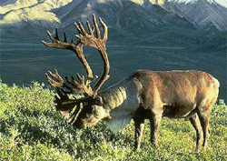
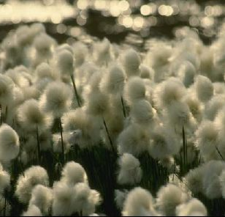
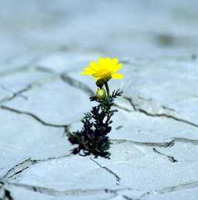
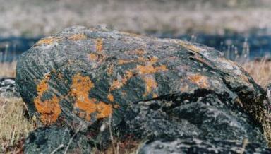
More Tundra Plants and Animals
Snowy Owl
Siberian Lynx
Caribou
Cotton Plants
Yellow Tundra Flower
Lichen

Slide 10
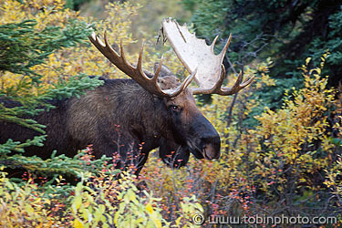
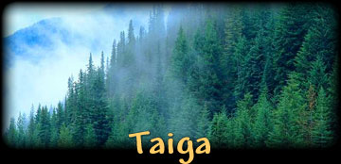
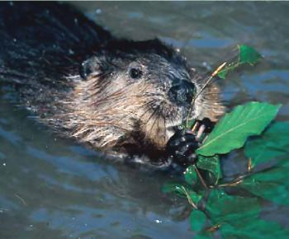
Moose
Eurasian Beaver
Location: Canada, Europe, Asia, and the United States
Description: Also known as “Coniferous forests.” Taiga regions have cold, long, snowy winters, and warm, humid summers; well-defined seasons
Plants: Coniferous-evergreen trees (trees that produce cones needles). The trees are narrow and grow very close together. This is so they can help protect each other from the weather. There are also moss, lichen, and other species of plants that live in the Taiga’s bogs.
Animals: Snow, cold, and a scarcity of food make life very difficult, especially in the winter. Some taiga animals migrate south, others go into hibernation, while others simply cope with the environment.
Notes:
Coniferous (needle-bearing) trees are abundant
Roots long to anchor trees
Needles long, thin and waxy
Low sunlight and poor soil keeps plants from growing on forest floor

Slide 11
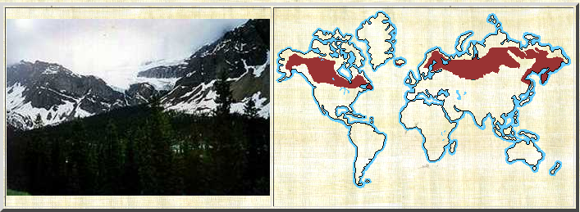
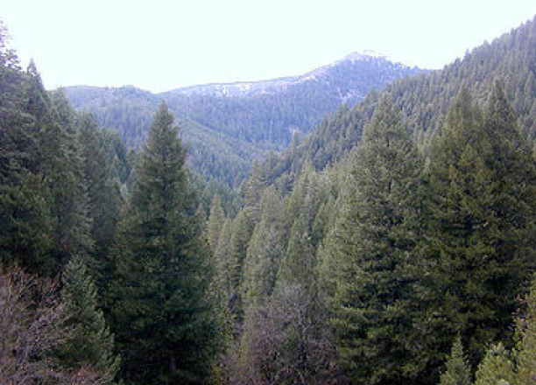
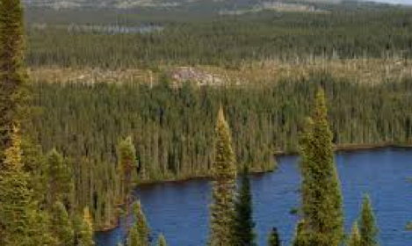
Evergreen Forest (Taiga)
A forest biome of evergreens trees in the upper northern latitudes.
What’s it like there?
The Taiga is the second coldest biome.
The average temperature is below freezing for six months out of the year.
The winters are really cold, with lots of snow.
The major plants in this biome are evergreen trees, which
Grow very close together and protect each other from the snow and cold.
Temperature | Rainfall | Soil
-10°C to 15°C (14°F to 59°F) | 0-25 cm per year | frozen
Notes:
Evergreens in the taiga tend to be thin and grow close together. This gives them protection from the cold and wind. Evergreens also are usually shaped like an upside down cone to protects the branches from breaking under the weight of all that snow. The snow slides right off the slanted branches.

Slide 12
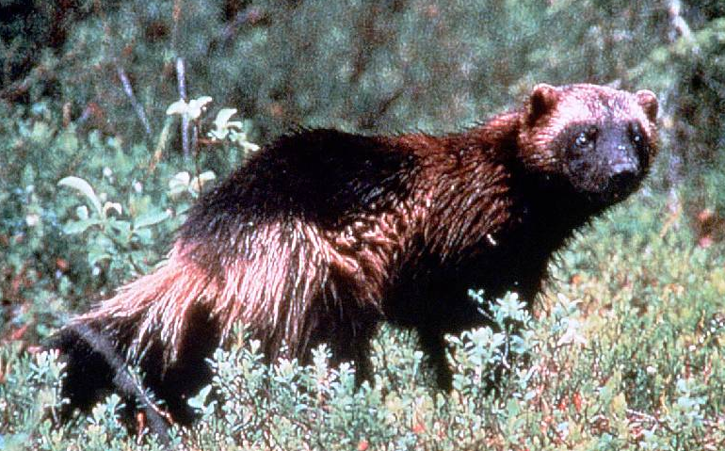
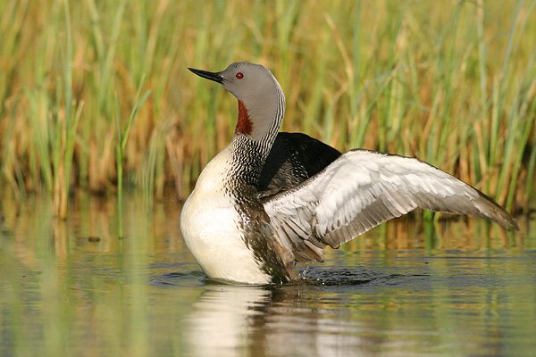
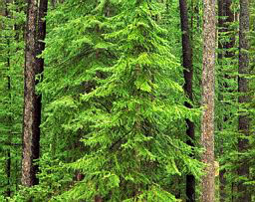
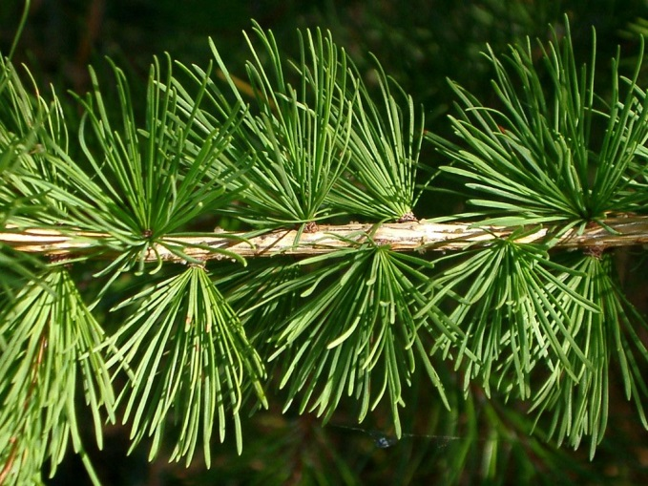
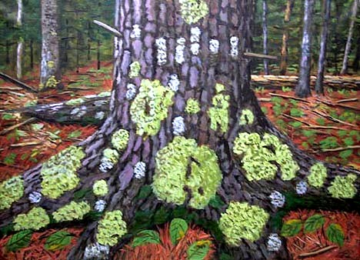
More Taiga Animals and Plants
Wolverine
Red Throated Loon
Lynx
Hemlock
Larch Needles
Lichen growing on a tree

