Slide 1
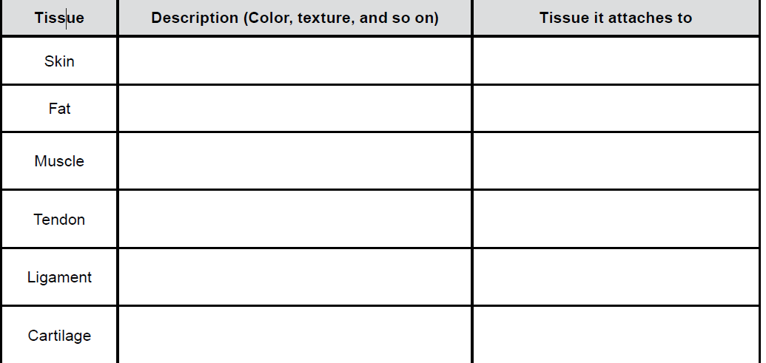
LAB: Chicken Wing Anatomy Complete the table below as you make your observations

