Slide 1
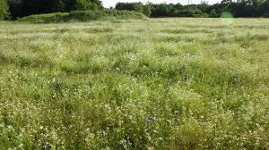
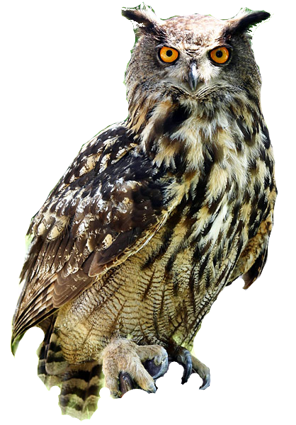
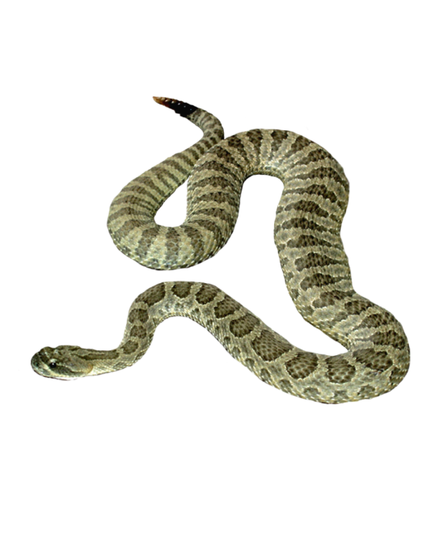
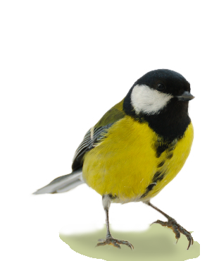
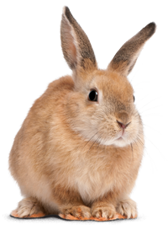
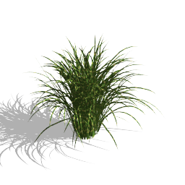
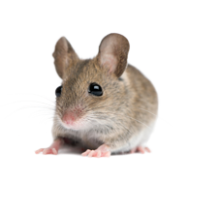
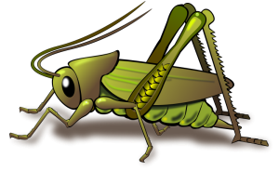
WHERE DO OWLS FIT INTO A FOOD WEB?
All owls are predators; they depend on other animals for food. However, very few predators feed on owls (except sometimes other owls). In fact, owls often eat other predators, such as weasels, bats, shrews and insect-eating birds. Therefore, owls hold a position at the top of the food chain. Like many predators, they feed from more than one link on the chain or web.
￼
Notes:
Have a volunteer or 2 draw the arrows

Slide 2
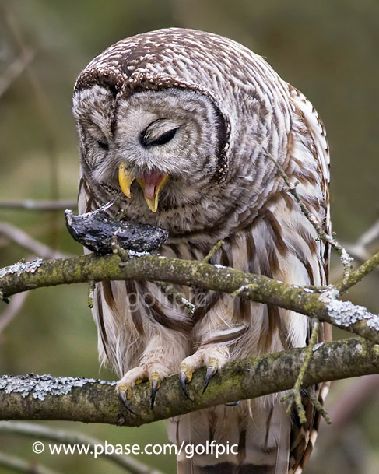
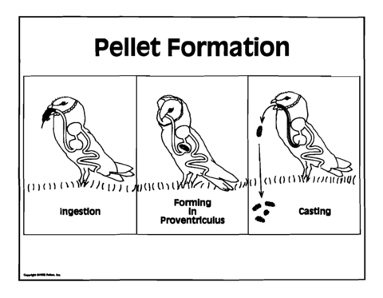
Most birds cannot chew their food and owls are no exception.
Owls usually swallow their prey whole. In owls, food passes directly from the mouth to the gizzard. The gizzard is an organ that uses digestive fluids and bits of sand and gravel to grind and dissolve all of the usable tissue from the prey.
The types of tissue that can be dissolved by an owl's digestive system include muscle, fat, skin, and internal organs. Some of these tissues (e.g., fur and bones) cannot be digested.
What happens to the indigestible material? Indigestible material left in the gizzard such as teeth, skulls, claws, and feathers are too dangerous to pass through the rest of the owl's digestive tract. To safely get rid of this material, the owl's gizzard compacts it into a tight pellet that the owl regurgitates. The regurgitated pellets are known as owl pellets.
Owl pellets are useful to researchers because they can find out quite a bit about an owl's lifestyle through careful examination of what’s inside.
WHAT CAN SCIENTISTS LEARN ABOUT OWLS BY STUDYING PELLETS?

Slide 3
Virtual Owl Pellet Dissection Lab
Click here to open the form
https://docs.google.com/forms/d/1RhY44Dwq4MooonUNdqKSiY2nVOkgzaujcx2ya-A2CyY/viewform?usp=send_form
Follow the directions on the form.
Dissect the Virtual Owl Pellet and arrange the preys bones on the chart
Then answer the questions below!
Notes:
app share show them how to get started

