Slide 1
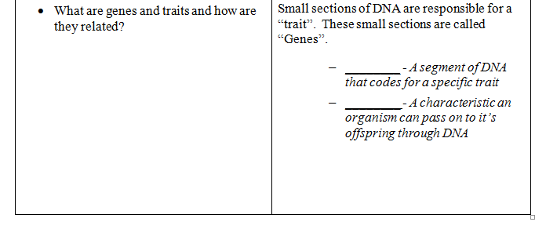
DO YOU HAVE THIS STUDY GUIDE???---------
TRAITS
Inherited
genetic
genes
Notes:
http://mrilifescience.weebly.com/study-guides.html
Let’s make sure you have your notes done!
Traits
Inherited
Genetic

Slide 2
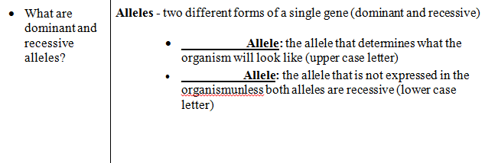
DNA
genetic
DNA
Dominant
Recessive
Notes:
DNA
Genetic
DNA

Slide 3
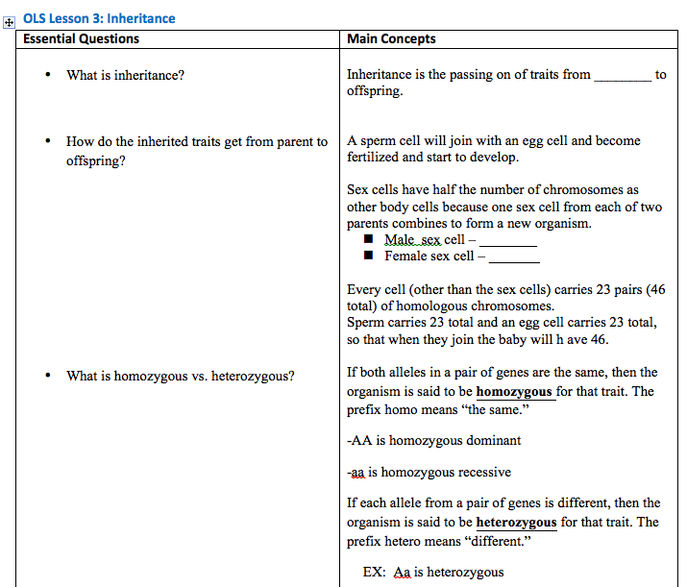
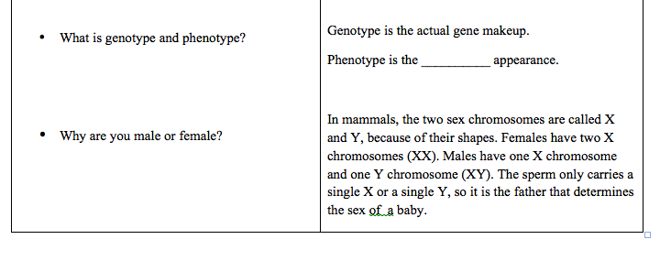
parent
23
23
physical

Slide 4
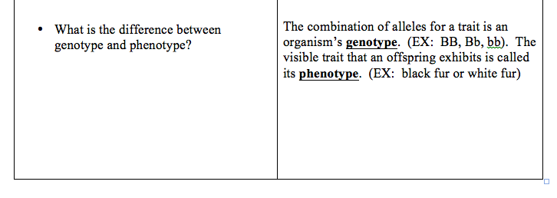
Punnett square

Slide 5
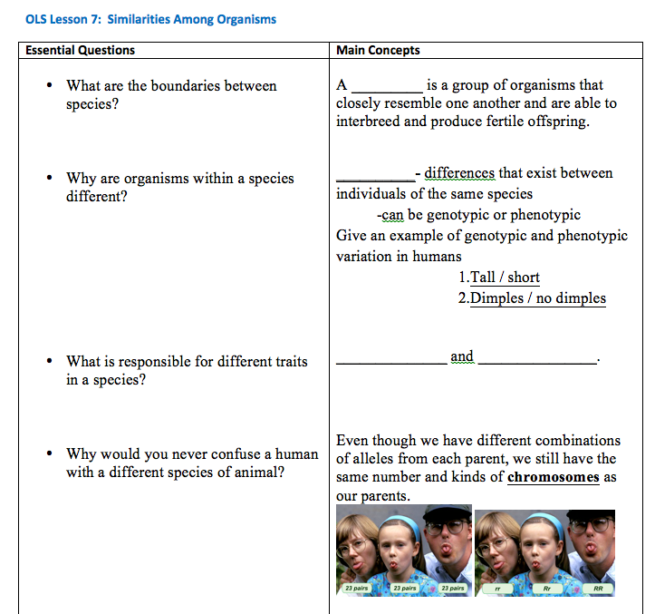
species
Variation
genes
chromosomes

Slide 6
DNA
Helix
Chromosome

Slide 7
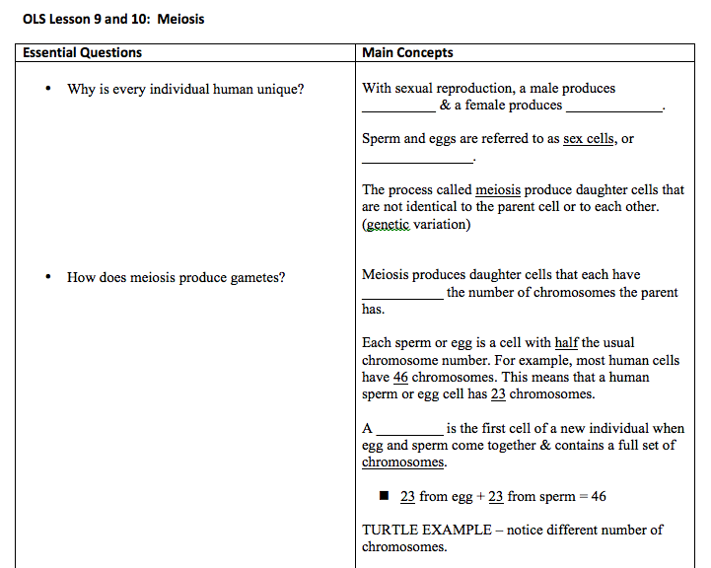
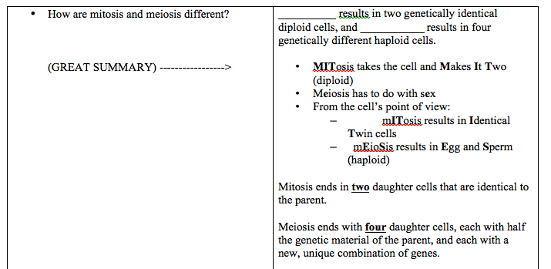
sperm,
eggs
gametes
half
zygote
MITOSIS
Meiosis

Slide 8
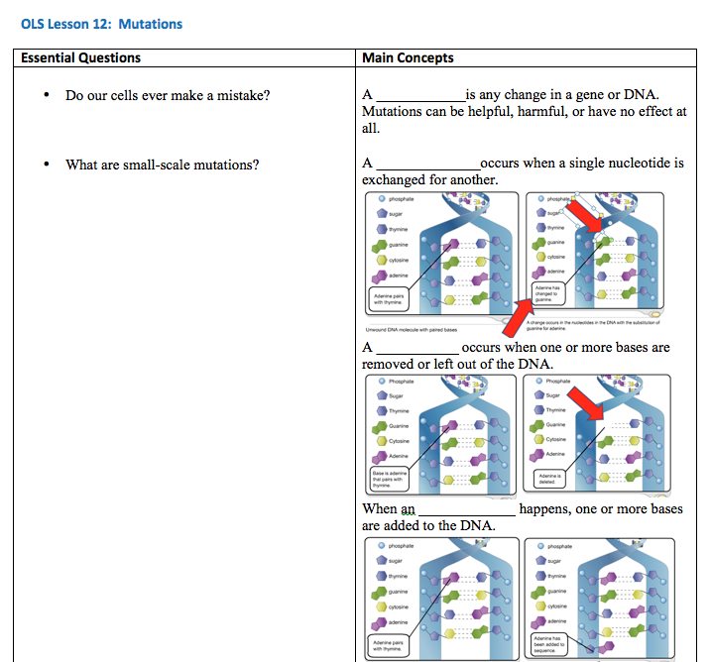
mutation
substitution
deletion
insertion

Slide 9
Natural Selection
Selective
Genetic Engineering

