Slide 1
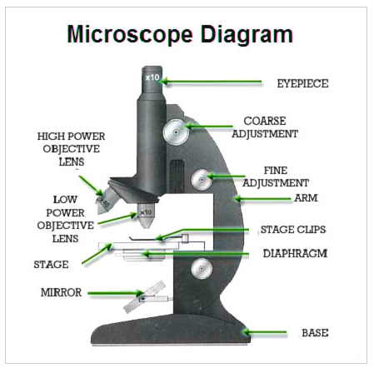
Using a Microscope
Unit 1 Lesson 12
What kingdom of organisms are we most likely to see in our pond water or soil samples?
Kingdom Animalia
Kingdom Plantae
Kingdom Fungi
Kingdom Protista
Notes:
D

Slide 2
Notes:
Volunteer me some answers every class.

Slide 3
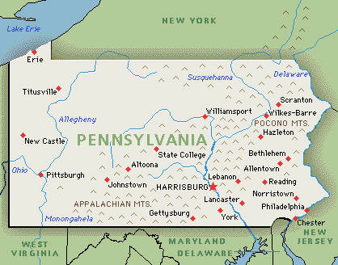
Week at a glance…
More Review
Monday 10/13 | Tuesday 10/14 | Wed. 10/16 | Thursday 10/17 | Friday 10/18 Review and quiz
NO SCHOOL!
Unit 2 Lesson 1: The cell
Unit 2 Lesson 2: microscope
Growing bacteria lab continued
Great state of PA state standards!
Today’s Objective:
define cells as the basic unit of structure and function in all living things and contains genetic information
Great state of PA State Standards
PA Standard S8. B1.1.1, S8.B.1.1.2, S8.b.1.1.3
Notes:
Students will define cells the basic unit of structure and function in all living things and contains genetic information

Slide 5
Student Page
53
Notes:
Volunteer me some answers every class.

Slide 7
Today’s Lab
Watch the video link below on setting up your specimen slides
Once you have watched and set up your slides, try to find organisms in your water samples and answer the questions on page 54 of your Student Pages
HAVE FUN!!!
Notes:
http://youtu.be/Bet5mX8CuzQ
http://quietube6.com/v.php/http://www.youtube.com/watch?v=Bet5mX8CuzQ&feature=youtu.be

Slide 8
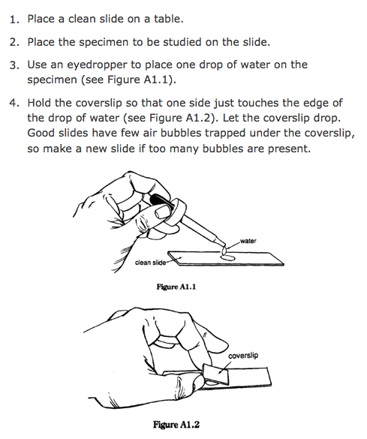
Preparing a microscope slide

Slide 9
Life Science Homework
Unit 2 lessons 2
Exit Ticket:
Were you able to see any interesting organisms in your pond water?
YES No

Slide 10
Eukarya Kingdoms- all have cells with a nucleus
Kingdom Protista- most are single celled,
Examples: ameoba, algae
Kingdom Fungi- many celled, cannot move, absorb nutrients from other organisms
Examples: mushrooms, molds, yeasts
Kingdom Plantae- many cells, make their own food (photosynthesis) cannot move
Examples: trees, flowers, ferns
Kingdom Animalia- multi-cellular, cannot make their own food

Slide 11
Differentiate- to develop from a simple, unspecialized cell into a cell that has a specific structure and job Advantages of being multi-cellular - they can perform more functions -they can be larger and use some types of cells to get food and maintain their structure Disadvantages- groups of cells depend on each other, when one group doesn’t work correctly, the entire organism is at risk
Unit 1 Lesson 11- Multi-Celled Organisms

Slide 12
10/7 Unit 1 Lesson 10 : Single Celled Organisms
VOCABULARY
Multicellular: composed of many cells
Protists: a diverse group of organisms in domain Eukarya; most single-celled organisms in domain Eukarya are protists
Single-celled: made of a single cell; the one cell carries out all functions
Unicellular: composed of a single cell
All living things are made of one or more cells
Single-celled organisms can be found almost everywhere on earth.
All three domains include single-celled organisms.
A single-celled organism must meet the 3 challenges of life:

